Slide 1

a
Go, change the world
RV College of
Engineering
DEPARTMENT OF COMPUTER SCIENCE AND ENGINEERING
Research Methodology(22IM21T) EL Phase1 Presentation on
‘Implementation of wifi handoff using ns2 simulator’
Presented By
Pavankumar Patil 1RV23SCN10
Sathwik M S 1RV23SCN14
Under the guidance of
Dr. Shanta Rangaswamy
Professor
Department of Computer Science Engineering,
RV College of Engineering, Bengaluru

Slide 2

TABLE OF CONTENTS
Introduction
Literature Survey
Problem Statement
Objectives
Implementation Details
RV College of
Engineering®
Go, change the world

Slide 3
Introduction
The wireless communication environment of today is characterized by Seamless and uninterrupted connectivity.
Heterogeneous settings, which combine various networks like Wi-Fi and LTE, are more typical as wireless technologies advance.
To preserve quality of service and user happiness in these situations, the ability to seamlessly shift a mobile device's connection from one network to another, known as vertical handoff, is essential.
This project uses the NS2 (Network Simulator 2) platform to implement and test Wi-Fi handoff.
The project aims to contribute to the study and optimization of seamless network transitions by modeling real-world events and evaluating the performance of Wi-Fi handoff mechanisms.
RV College of
Engineering®
Go, change the world

Slide 4
LITERATURE SURVEY
1 . Title: “Comparison of Vertical Handover Decision-Based Techniques in Heterogeneous Networks”
[Oluwaseun A. Adedeji, Olumide S. Adewale, and Oludayo O. Olugbara. 2018, International Journal of Communications, Network and System Sciences - Volume: 11, Issue: 12 , (pp: 239-259)]
Key Attributes: The paper compares multiple criteria handover to traditional single relative signal strength based handover and analyzes the performance of a fuzzy-based handover decision technique. It presents a framework that shows superiority in the provision of seamless handover between different network types. The paper also explains the functionalities and roles of components of the framework in optimization.
Challenges: The paper identifies the problem of poor QoS and quality of experience (QoE) in heterogeneous networks, which is attributed to the type of handover mechanism implemented. The paper also highlights the challenges involved in handover between different network types in heterogeneous networks.
RV College of
Engineering®
Go, change the world

Slide 5
2. Title: "Survey of Seamless Vertical Handoff Schemes for WiFi/WiMAX Heterogeneous Network"
[Ajmal Mohammed V M, Prapu Premanath, Lalji Cyriac. 2021, International Journal of Science and Research (IJSR)- Volume: 10,Issue: 3, ISSN: 2319-7064,(pp: 1-6)]
Key Attributes: The paper surveys different handoff mechanisms used in various papers to achieve uninterrupted services and minimum handoff time for mobile nodes moving across areas covered by different access technologies. It also discusses the benefits of using heterogeneous handoff in wireless and mobile communication technologies.
Challenges: The paper mentions some of the challenges in implementing seamless vertical handoff schemes, such as the need for efficient handoff decision algorithms, the need for standardization of interfaces between different access technologies, and the need for security mechanisms to protect against attacks during handoff.
RV College of
Engineering®
Go, change the world

Slide 6
PROBLEM STATEMENT
Using network Simulator 2 (NS2), simulate a wireless network to interact in a task, and demonstrate Wi-Fi handoff within the network architecture using NS2.
Wireless handoff is used widely in cutting- edge wireless networking; it enables a client device to switch between APs preserving seamless connectivity.
RV College of
Engineering®
Go, change the world

Slide 7
OBJECTIVES
The objective of the project are as follows:
• To simulate a wireless network using NS2(Network Simulator 2)
• To demonstrate Wi-Fi handoff in the wireless network topology.
RV College of
Engineering®
Go, change the world

Slide 8
Implementation Details
Algorithms:
➢ Signal Strength-Based Algorithm: This algorithm triggers a handoff when the signal strength of the current network falls below a predefined threshold.
➢ Hysteresis Algorithm: It introduces a hysteresis margin to avoid frequent handoffs due to minor signal fluctuations. A handoff occurs when the signal strength crosses both high and low thresholds.
➢ Load Balancing Algorithm: This algorithm considers the network load, ensuring that a network isn't overloaded before initiating a handoff.
RV College of
Engineering®
Go, change the world

Slide 9
Tools and Techniques Used:
➢ Network Setup: Create a network topology with Wi-Fi nodes. Configure network parameters like data rates, channel models, and IP addressing.
➢ Mobility Modeling: Set up mobility models to simulate device movements within the network.
➢ Handoff Logic: Implement the handoff decision logic based on your chosen algorithm(s). This logic should determine when to initiate a handoff.
➢ Logging and Data Collection: Implement logging to collect relevant simulation data, including signal strengths and handoff events.
➢ Simulation Execution: Run the NS-2 simulation with your custom handoff logic and mobility models.
➢ Data Analysis: Analyze simulation results using data analysis tools and techniques.
➢ Evaluation and Optimization: Evaluate the performance of your vertical handoff algorithm and optimize it as needed based on your analysis.
RV College of
Engineering®
Go, change the world

Slide 10
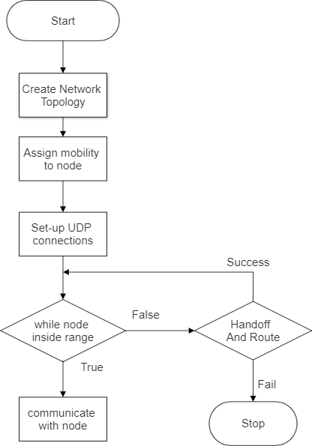
Flowchart:
RV College of
Engineering®
Go, change the world

Slide 11
RV College of
Engineering®
Go, change the world
THANK YOU

